Slide 1


1.31.12

Slide 2
Fun Fact
Adults who began volunteering as youth are twice as likely to volunteer as those who did not volunteer when they were younger.

Slide 3

Pledge
I pledge, on my honor,
to uphold the Objects of Key Club International;
to build my home, school and community;
to serve my nation and God;
and combat all forces which tend to undermine these institutions

Slide 4
T-shirts
  We still need a t-shirt design for our shirts this year
  Will be entered in the contest at DCON
  Top 2 designs: 1 hr

Slide 5
Canned Goods
1 in 6 Americans does not have enough access to food
Seven states exhibited statistically significant higher household food insecurity rates than the U.S. national average 2009-2011:
United States 14.7%
Mississippi 19.2%
Texas 18.5%
Arkansas 19.2%
Alabama 17.4%
Georgia 17.4%
Florida 16.2%
North Carolina 17.1%

Slide 6
Canned Food Drive
Bring in canned goods
  5 cans = 1 hr
  2 hrs
Feb 23 (Saturday)
  2 p.m. Houston Food Bank

Slide 7

DCON 2013
The Official Tentative Plan (01.24.13)

Slide 8
Basic Info
Where?
  Dallas, TX
  Sheraton Hotel
When?
  April 4-7
Who?
  Any Key Clubber!

Slide 9
WHO?
This is where I tell you who'll be there...

Slide 10
The "Importants"
District Officers & Lt. Governors from all over T-O District
Important Kiwanians
1500+ Key Club members and sponsors from all over Texas and Oklahoma
Key note speaker, Rhett Laubach
YOU!.... And more ☺

Slide 11
WHAT?
This is where I tell you some facts...

Slide 12

Events
Governor’s Ball
Seminars
Elevator Rides
Much more!

Slide 13

Dress Code
casual AND formal/business attire

Slide 14
WHEN?
This is where I tell you about DCON times...

Slide 15
The Week of DCON...
is the week of STAAR testing... :(
April 4th is last day of STAAR and we will leave promptly after school (preferably a bit before)
Friday, April 5th, will be an excused absence
We get back on Sunday afternoon

Slide 16
WHERE?
This is where I tell you about the location...

Slide 17
Hotel Information
The Sheraton Dallas Hotel is a landmark in the downtown arts and financial district.
It features 1,840 guest rooms, with gorgeous city views from 242 suites.
Convention guests will enjoy relaxing in the comfort of an oversized room with a crisp white Sheraton Sweet Sleeper TM Bed, flat panel HDTV, iPod docking station, and eco-friendly features.
A $90 million redesign brings many new amenities to this classic meeting space in the heart of the city.

Slide 18

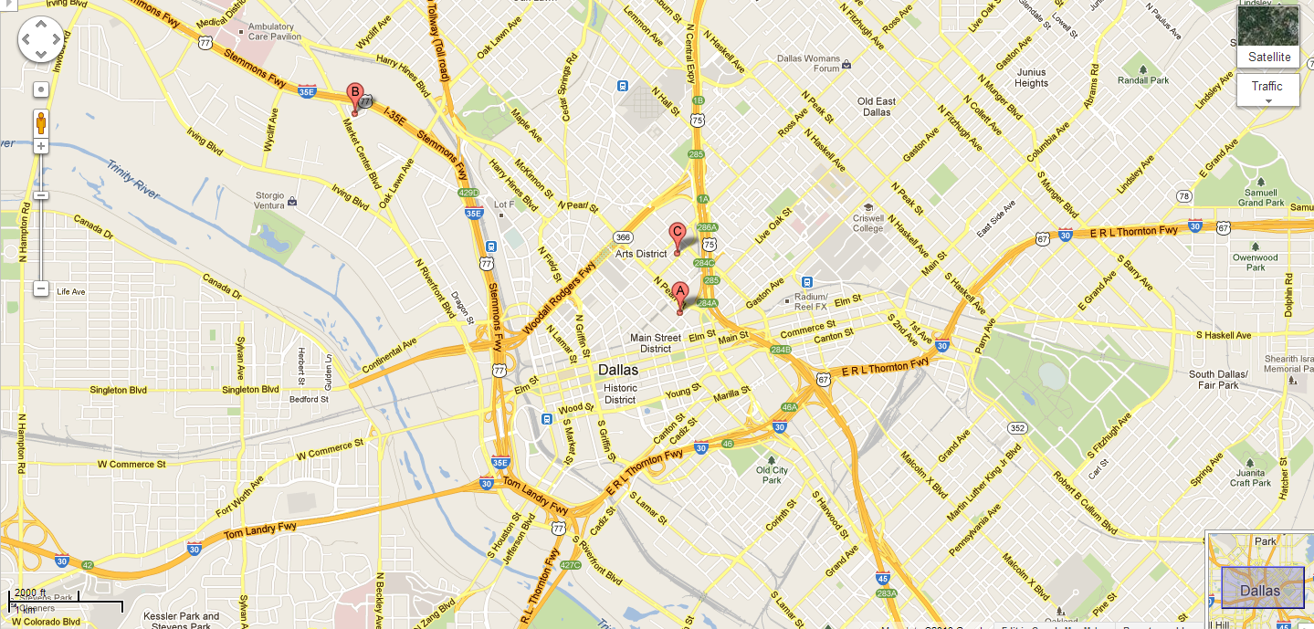

Slide 19
WHY?
This is where I convince you to go...

Slide 20
Seniors... Scholarships...
Qualified seniors are encouraged to apply for college scholarships sponsored by the Texas- Oklahoma District Kiwanis Foundation.
The Foundation grants thousands of dollars in scholarship funds each year to Texas-Oklahoma Key Club and CKI members.
This is an outstanding opportunity to get help with your college funding!
Candidates should have a strong Key Club service record, as well as high academic standards.
If accepted, candidates will be scheduled for a scholarship interview held at District Convention.
For more information about the T-O Kiwanis Foundation scholarship program and the application, look at the scholarship folder found on with the other District Convention resources online.

Slide 21
Important Key Club Events
District Officer Election
  Regional Caucuses
House of Delegates
Leadership forums
Award Show/Banquet/Governor's Ball
Instatement of the incoming officers

Slide 22
HOW?
This is where I tell you the deets...

Slide 23
The Cost...
Registration Fee (Early/Normal): $110/$140
Discounted Hotel Price: $135/night
Transportation (Bus of 56): ~ $1300
(/amount of attendees): $23.21...
Personal Stipend: $ x
Total: $280~300
*Early deadline is Mar. 15, 2013

Slide 24
What You Get...
The convention registration fee covers admission to all general sessions, including the Opening Session, Leadership Luncheon, Awards Banquet and Farewell Breakfast.
Convention guests gain admission to all breakout forums, the opportunity to enter a variety of competitions (see Code of Contests and Awards), entry into the Governor's Ball, and rights to vote in Regional Caucuses and the House of Delegates (see District Bylaws and Code for Elections and House of Delegates for eligibility).
Each attendee will receive forum materials, the convention program book, the souvenir convention bag, official convention t-shirt, and a Texas- Oklahoma District convention lapel pin.
Key Club guests will enjoy three catered meals and dining service.

Slide 25
The Deposit...
$100 Deposit due Feb. 8th to Ms. Fader
  please seal in an envelope with your name on it
Deposit is refundable
Discounts projected (FUNDRAISERS!)

Slide 26
Reasons to Turn In Money Soon...
Because I like to make the lives of the officers easier
I am extremely hyped about DCON and I can't stop dreaming about it
The sooner we get all payments in, the better seating we get (Section A-D)

Slide 27
MY GOALS FOR DCON 2013
At max 48-50 members attending from Katy
  around 30 from CRHS
First come, first serve!

Slide 28
It's not too late
SIGN UP NOW FOR THE TIME OF YOUR LIFE!

Slide 29
Next Meeting
FEB 14

Slide 30
Stay Posted
Website: taylorkeyclub.weebly.com
Facebook: THSKEYCLUB1213

